Slide 1

PROJECT on AI

Slide 2
GROUP 7:
HARDIK SHARMA – 20BCS4123
PRIYANSHU RANA – 20BCS4096
SNEHASISH DEY - 20BCS4084
RITEEK RAJ MODI – 20BCS4115

Slide 3
CONTENTS :-
PROPOSED PROJECT TOPICS
FEATURES/ FUNCTIONALITIES OF PROJECT
SOFTWARE USED
IMPORTANTANCE/SIGNIFICANCE OF PROJECT
USES/BENEFITS OF THIS PROJECT

Slide 4
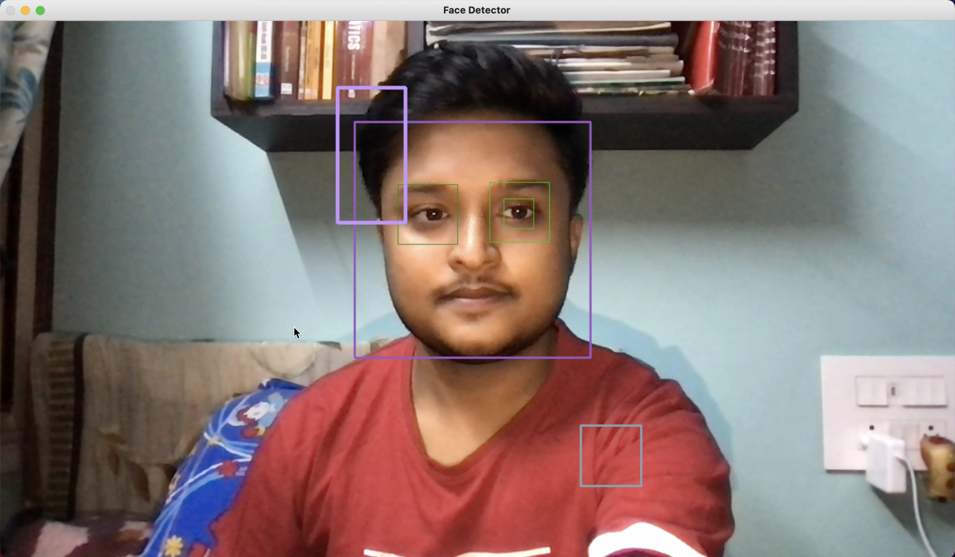
Motion Detector

Slide 5
FEATURES/FUNCTIONALITIES OF MOTION DETECTOR :-
Save energy by using motion sensor lighting in unoccupied spaces.
They are one of most common and most useful alarm sensors, providing convenience, safety and helping to conserve resources.
Motion detection is a software algorithm designed to detect moving objects in a specific area and create an alert.

Slide 6
SOFTWARE USED IN MOTION DETECTOR :-
Python 3.8
PyCharm IDE
cv2 python module for AI recognition
Datetime python module for showing date and time of detection.
OS python module for speaking purposes.
Pandas python module to make a .csv file to save the time of detection.
Haarcascade Face Detection Algorithm

Slide 7
STEPS :-
Importing python modules.
Declaring variables.
Capturing my webcam of my device.
Running a while look until pressed ‘q’.
Starting to color correct the video feed.
Taking data from the video feed.
Checking for the area where the motion is detected.
Creating the rectangle for detection.
Making “Motion Detected” sound on detection.
Appending the detection list to pandas.
Displaying all the windows.
Creating the .csv file by using pandas.

Slide 8
IMPORTANCE :-
Essentially, a motion detection software is a computer program that allows you to be in control of your surveillance work. With the software, it is possible to turn an average webcam on computer or other strategically positioned into surveillance cameras with motion detection abilities.
The tool is light and monitors the surrounding of your computer through the built-in camera as well as any other camera that may be connected to the computer.

